Slide 1
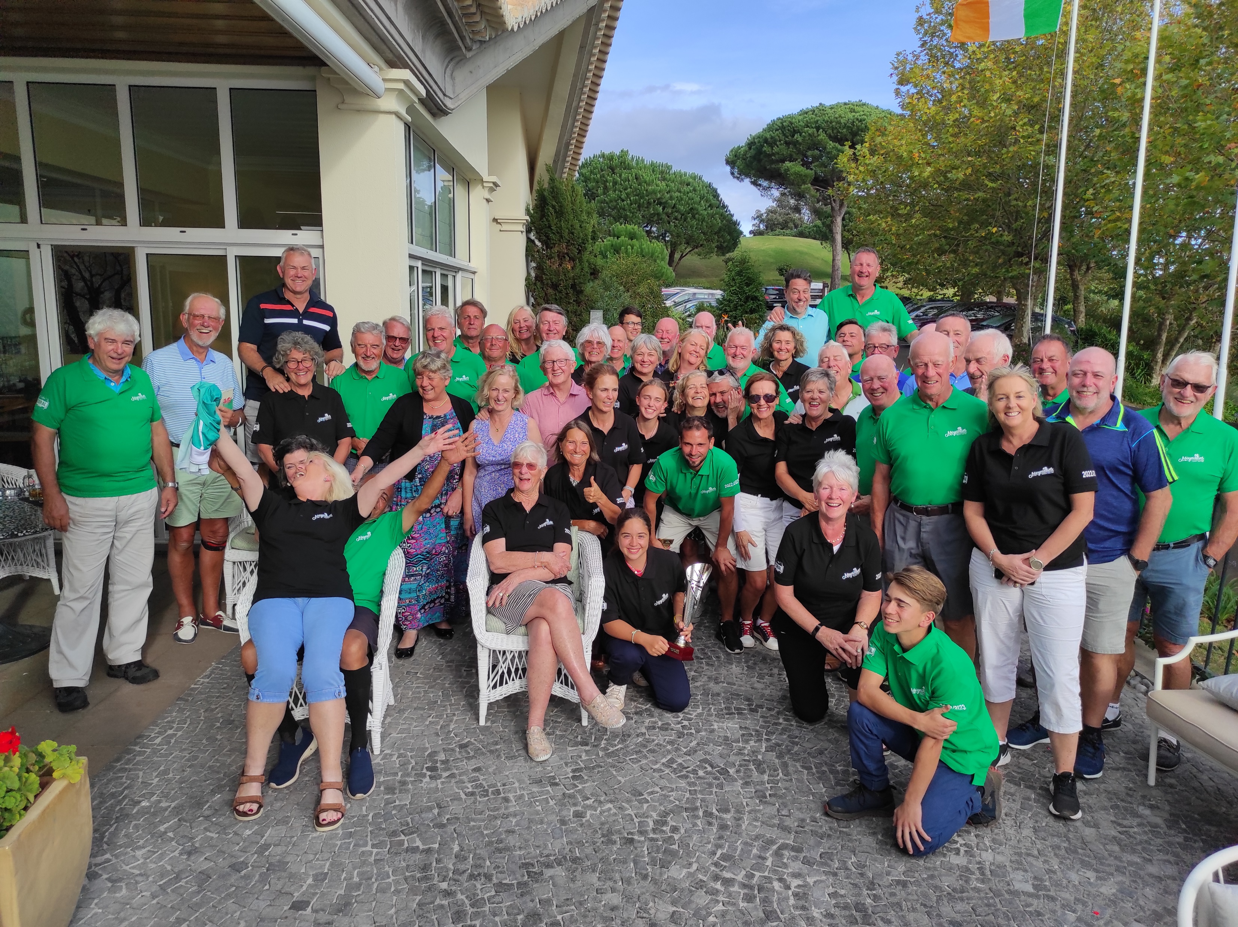
28
29
Moynihans Open
OCT
2023
27.10.2023 – Santo da Serra | Individual Stableford.
28.10.2023 – Palheiro Golf | Match Play 4BBB| starting at 11:00 a.m.
Bacon roll sandwiches + coffee from 10:30 a.m.
29.10.2023 – Palheiro Golf | Individual Stableford | Shot Gun 09h30.
Lunch + prize giving |Clubhouse Restaurant | 15h00.
Entries open until 25.10.2023..
For golf lovers

